Slide 1
Regular Expressions
Practice

Slide 2
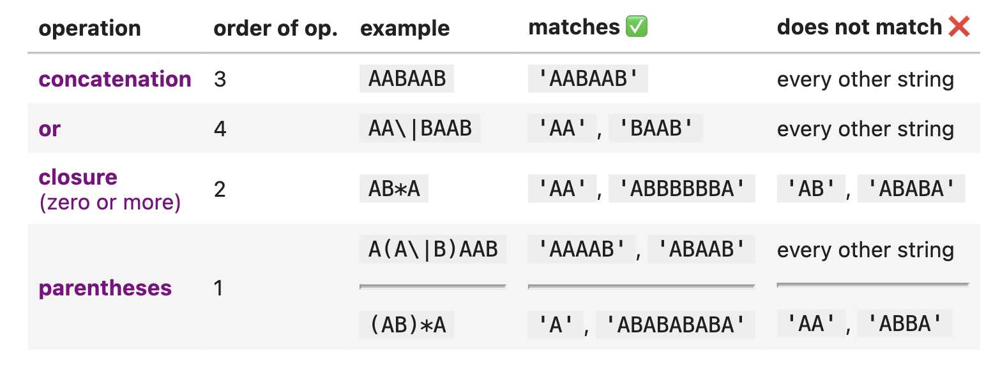
Fundamental Building Blocks

Slide 3
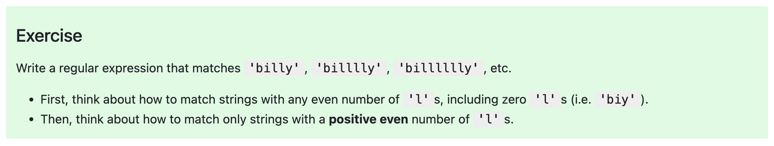
Try It! ☺

Slide 4
Solutions
bi(ll)*y will match any even number of 'l's, including 0.
To match only a positive even number of 'l’s:
This specifies the regular expression bill(ll)*y

Slide 5
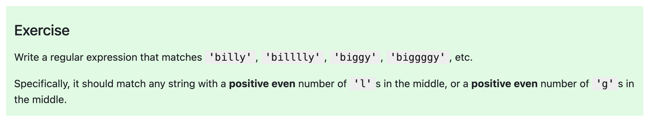
Try It! ☺

Slide 6
Solutions
Possible answers:
bi(ll(ll)*|gg(gg)*)y or
bill(ll)*y|bigg(gg)*y.

Slide 7
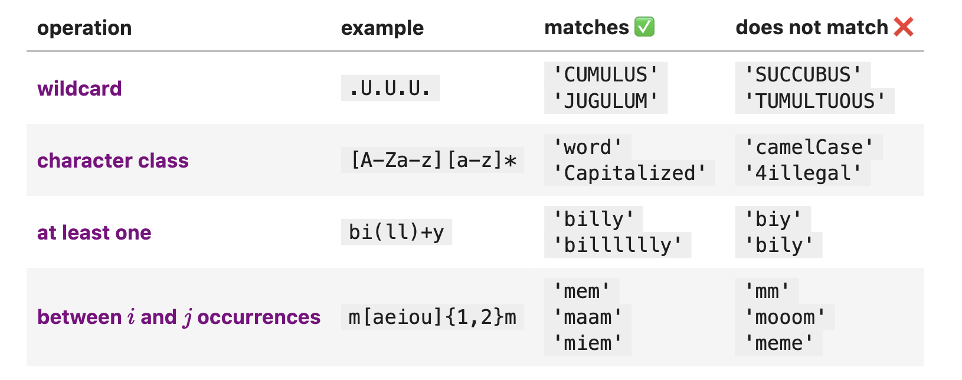
Intermediate RegEx
Example (character classes, at least one): [A-E]+ is just shortform for (A|B|C|D|E)(A|B|C|D|E)*.

Slide 8
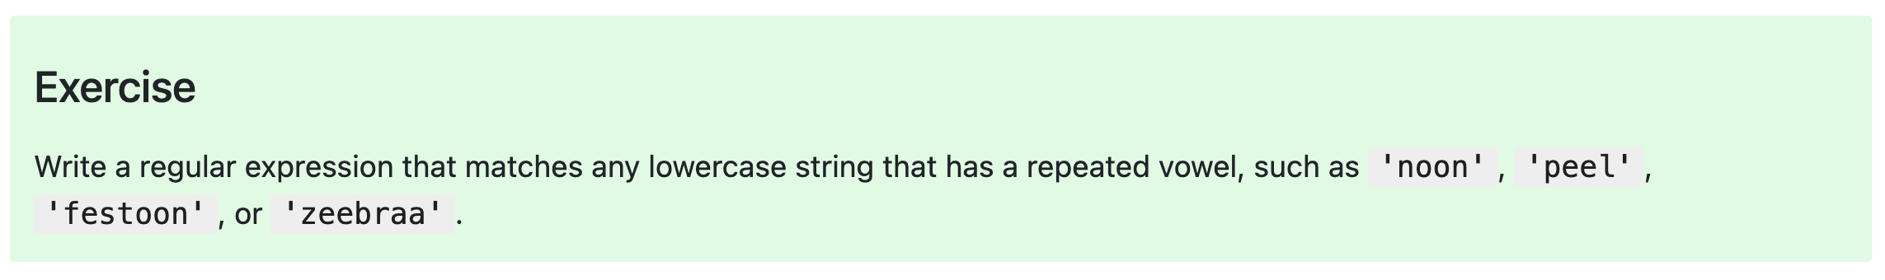
Try It! :)

Slide 9
Solution
One answer:
[a-z]*(aa|ee|ii|oo|uu)[a-z]*

Slide 10
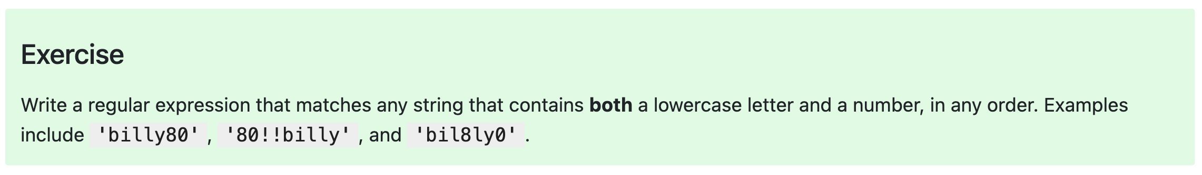
Try It! ☺

Slide 11
Solution
One answer: (.*[a-z].*[0-9].*)|(.*[0-9].*[a-z].*)

Slide 12
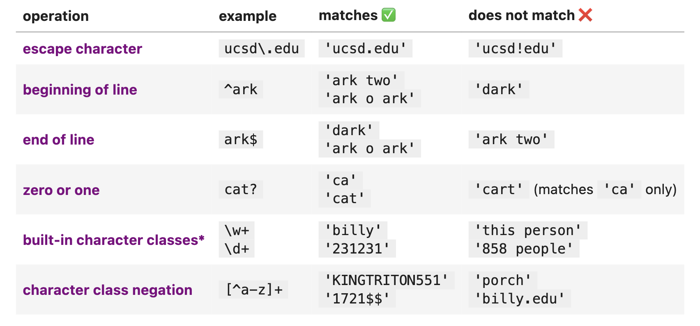
More RegEx!
\d refers to digits.
\w refers to alphanumeric characters ([A-Z][a-z][0-9]_).
\s refers to whitespace.
\b is a word boundary.

Slide 13
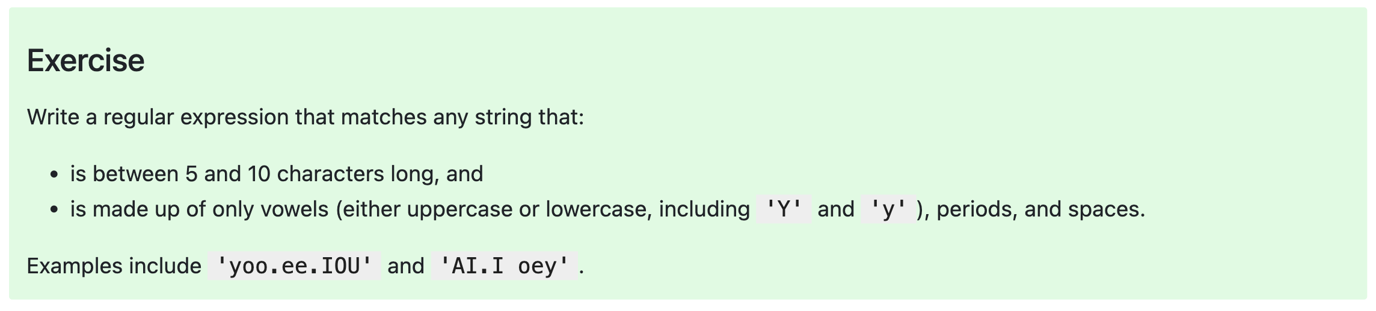
Try It! ☺

Slide 14
A Solution
One answer: ^[aeiouyAEIOUY. ]{5,10}$

